Slide 1

Project Demonstration
Adam Johnstone (GLJD44)

Slide 2
Overview
Reminder of project deliverables
What I have achieved so far
Comparison to initial Gantt chart
Next steps
Code review
Questions
Bibliography

Slide 3

Reminder of Project Deliverables
Basic – Replication of Sandwich attack on KASUMI
Replicate the results achieved by Shamir et al from the paper [1]
Basic - Replication of a Related Key Boomerang attack on GOST
Replicate the results achieved by Rudskoy from the paper [2]
Intermediate - Establish the feasibility of the Sandwich Atack on GOST
Analyse the differential probabilities to establish whether the Boomerang attack on GOST can be adapted into a Sandwich attack
Advanced - Implement a Sandwich attack on GOST
Assuming the attack seems feasible, implement the Sandwich attack on GOST
Advanced - Add to Sandwich attack documentation
If the attack proves infeasible, create easy to understand explanations of the Sandwich attack

Slide 4
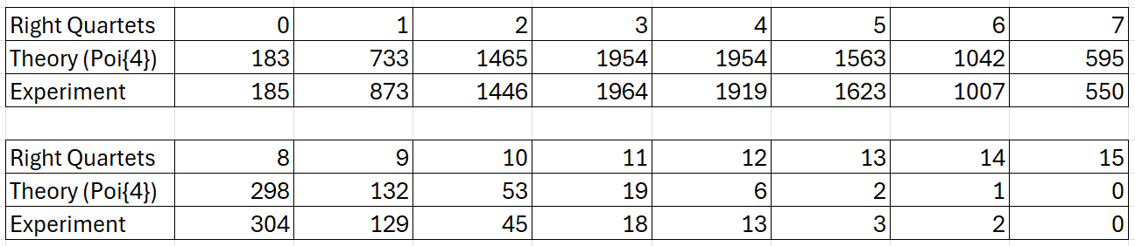
What I have achieved so far
Basic – Replication of Sandwich attack on KASUMI
Successfully implemented – is able to produce ‘right quartets’ with random starting plaintext and key
Started – Replicating the experimental verification from [1] (see table below)
Table 1: The number of right quartets in 10,000 experiments
The table won’t line up directly to [1] as Shamir et al implement a slight change to the differential which increases the probability of finding a right quartet by a factor of 2. Due to this, I think my tests will line up with a Poisson distribution with a mean of 4 rather than 8. They also run 100,000 tests which I haven’t done (yet) and so my results may not fit the Poisson model as closely. However, as can be seen in Table 1 the results I achieve are still reasonably close to the expected and should get closer after running the remaining 90,000 tests.

Slide 5
What I have achieved so far – cont.
Basic – Replication of a Related Key Boomerang attack on GOST
Started – Implementation has been coded but currently doesn’t produce ‘right quartets’, debugging needed.
Intermediate - Establish the feasibility of the Sandwich Atack on GOST
Started – Have coded and received results from differential analysis (similar to the cryptography practical) although I am yet to review them in detail. However, from my initial overview it would appear the results could bode well as the probabilities of certain GOST differentials appearing seems higher than those for DES.
Advanced – I am yet to start on any of the advanced deliverables

Slide 6
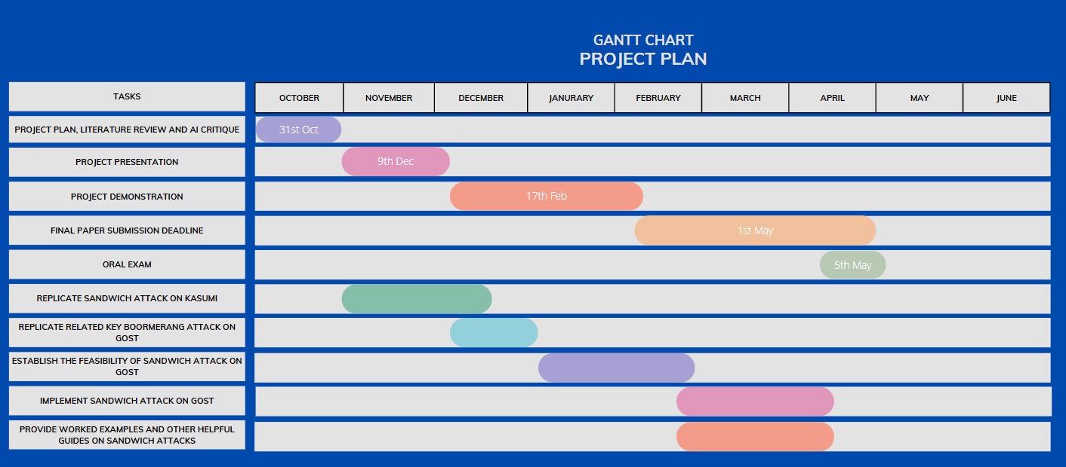
Comparison to Initial Gantt Chart
Red Line – Where I should be according to the original plan
Green Zone – Where I am currently
Reasons for being behind schedule:
Initial paper (and possibly current paper) contain errors which weren’t realised immediately leading to the Sandwich attack on KASUMI being delayed. Solved by finding an updated paper.
KASUMI documentation is written in C which caused errors when trying to translate to python leading to the implementation of KASUMI being delayed. Solved by utilising an existing implementation of KASUMI.
General workload of other courses meant less time was spent on this project than expected. Contingences were put in place for this however the other delays have meant I am still behind schedule.
Although I am behind schedule it is not too far behind, and the time can easily be made up by managing my time better and focussing slightly more on this project.

Slide 7
Next Steps
Fix the implementation of the Boomerang attack on GOST and verify its correctness.
Fully analyse the results from the differential analysis, perform more analysis if needed and come to a conclusion on the feasibility of implementing the Sandwich attack on GOST.
Begin to consider the advanced deliverables based on the feasibility conclusion.
Start thinking about writing the final report.

Slide 8
Code Review
See VSCode

Slide 9
Questions

Slide 10
Bibliography
Dunkelman, O., Keller, N. & Shamir, A. A Practical-Time Related-Key Attack on the KASUMI Cryptosystem Used in GSM and 3G Telephony. J Cryptol 27, 824–849 (2014). https://doi.org/10.1007/s00145-013-9154-9
Rudskoy, V. (2010). On zero practical significance of “Key recovery attack on full GOST block cipher with zero time and memory”. Cryptology ePrint Archive, Paper 2010/111. https://eprint.iacr.org/2010/111

